Slide 1
Inserting the required data into tables.

Slide 2
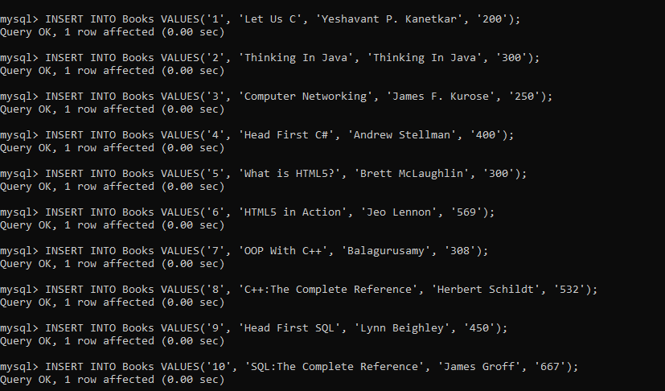
Table Books:

Slide 3
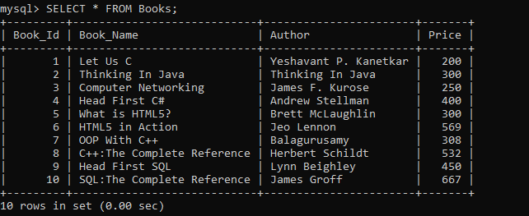
Table Books:

Slide 4
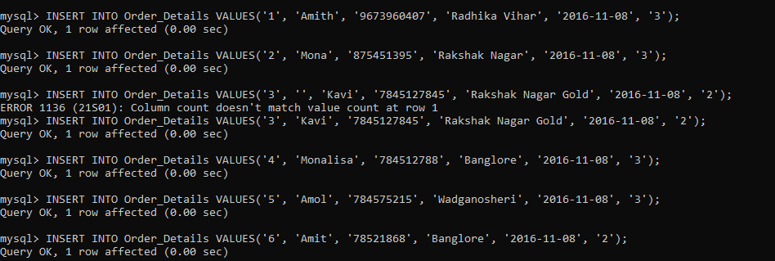
Table Order_Details

Slide 5
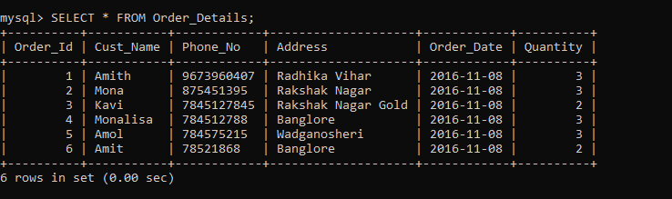
Table Order_Details

Slide 6
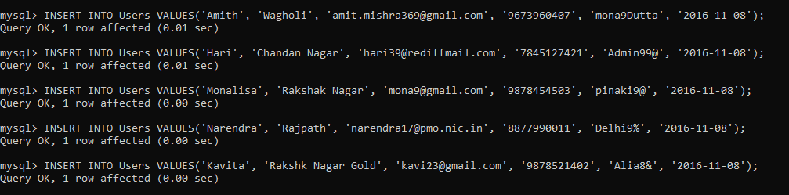
Table Users

Slide 7
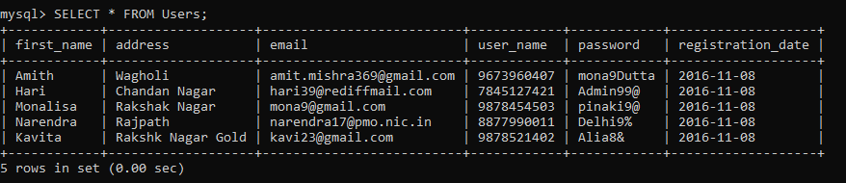
Table Users

